Slide 1

IBM Data Science Capstone Project
Battle of Neighborhoods
Notes:
To change the image on this slide, select the picture and delete it. Then click the Pictures icon in the placeholder to insert your own image.

Slide 2
Introduction and Business Problem
Gaming café – as a Business in Chennai
Chennai - 142 Neighborhoods, Which ones to choose?
Target customers – Age group 10 - 30 yrs.
Identifying good neighborhood – Near Schools, Colleges, etc.
Competition – Identifying existing cafés and their business.
Neighborhoods with good financial background. Ready to spend?
Services needed – Power, Connectivity, Food and Staff.

Slide 3
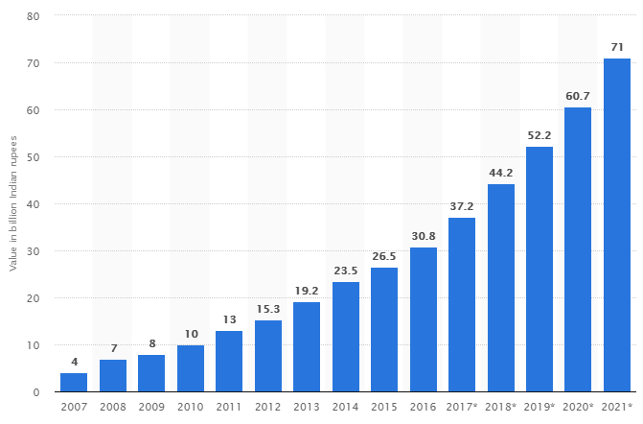
Value of the gaming industry in India from 2007 to 2021 (in billion Indian rupees)

Slide 4
Requirements for Gaming Café.
It should be located near School and Colleges to attract more customers.
It should be located in a posh place where people are willing to spend money on gaming.
It should be close to food stores, so that fresh stock can be maintained in café.
It should have faster network and continuous power supply.
Computer hardware and service should be nearby.
Good Ambience and friendly staff.

Slide 5
Four Step Process to find desired Location
Arriving at the location
Identifying Competition in market
Identifying Schools and Colleges nearby
Identifying and analyzing neighborhoods

Slide 6
Identifying and analyzing neighborhoods
There are more than 142 neighborhoods in Chennai.
We have use K-Means Clustering algorithm to Cluster neighbor hoods into segments which are similar to each other.
In this way we can find all the posh areas, middle class areas and lower class areas and suburb’s
After analyzing the clusters, we are more interested in cluster 2 neighborhoods.

Slide 7
Identifying Schools and Colleges
The data we are using from analysis is from FOURSQARE API’s using which we get venues near by desired neighborhoods
Latitude and Longitude of neighborhoods are derived from OpenStreetMap Nominatim API.
With the help of these API’s we Extract the numbers of Schools and Colleges for the neighborhoods in the Cluster 2.

Slide 8
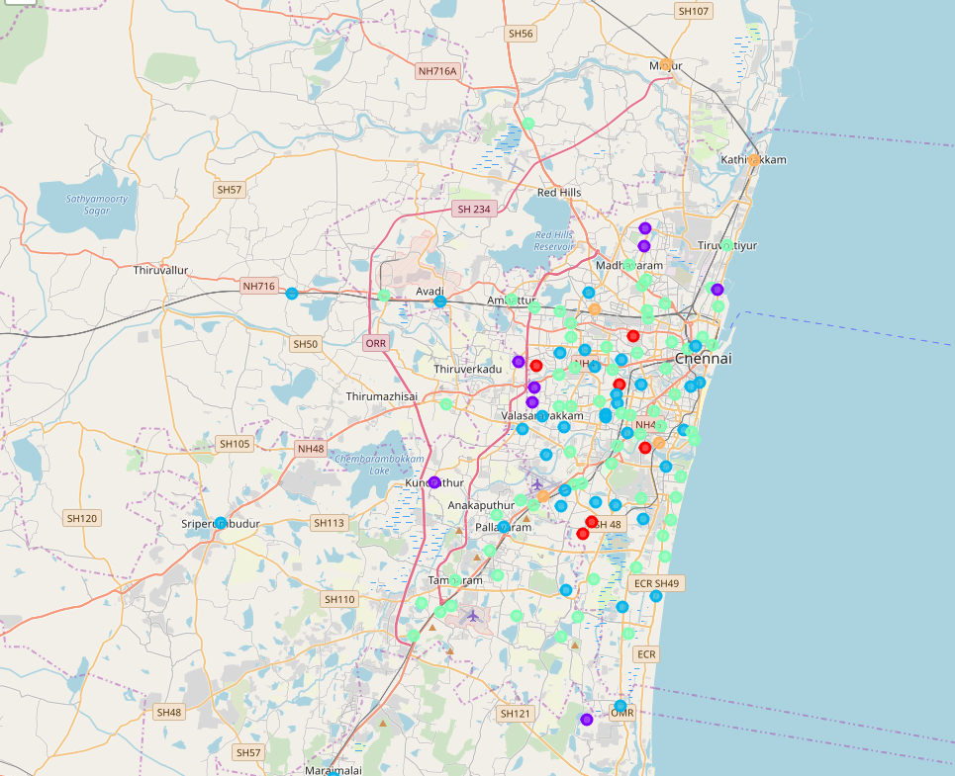
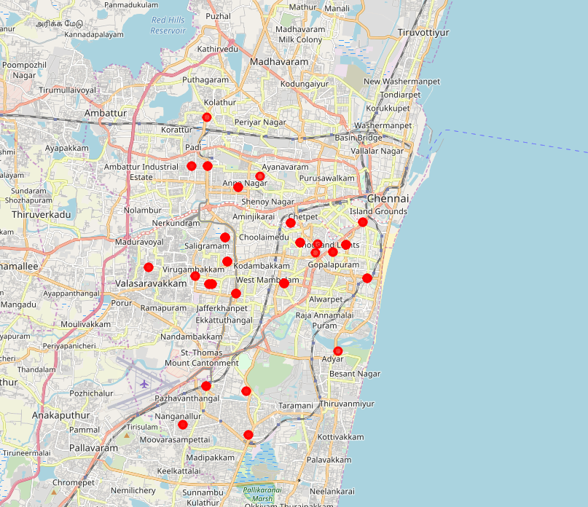
Potential areas for opening Gaming Cafe
Sky Blue Dot’s – Potential areas of interest
Red Dots – Existing Cafes

Slide 9
Finalizing the Best locations in Cluster 2
To finalize the location we have considered the following parameters and added weights to them to get a final score
Number of Schools added weight of ‘1’
Number of Colleges added weight of ‘2’
Number of already existing Gaming Cafes ‘-1’
From the above result we conclude Mylapore as our best choice to open a new gaming café.

Slide 10
Detail’s of Mylapore
The population of Mylapore is estimated to be around 150,000 to 300,000
ACT Fibre Net is very reliable good service covering the area
Location is close to shore
Only 1 existing Gaming Café
36 Schools and 49 Colleges nearby
Good food stores and supplies.
Lot of floating population and a rich-neighbourhood.

Slide 11
THANK YOU

